Slide 1

TMDb Movie 2015

Slide 2

Introduction
About datasets
Columns details
Insights of analysis
Questions for analysis
Plots of Analysis
Overview for Notebook
Conclusion

Slide 3
About datasets
This data set contains information about (10866) movies collected from The Movie Database 2015

Slide 4
Columns details
ID: Movie ID
Popularity: Popularity score
Budget: Amount spent to make the movie
Revenue: Amount realized from the movie
original title: Movie title
Cast: Actors & Actresses in the movie
Homepage: Movie website
Director: Director(s) of the movie
Tagline: Catchphrase(s)/slogan of the movie
keywords: Words associated with a movie
Overview: Movie Summary
Runtime: length of a movie
Genres: Category
Production companies: Companies that produced the movie
Release date: Date movie was released
Vote count:
Vote average
Release year: year movie was released
Budget adj: Budget In terms of 2010 dollars
Revenue adj: Revenue in terms of 2010 dollars

Slide 5
Insight(s) for Analysis
What are all times highest and lowest profit movie?
What is all times top 10 movies which earn the highest profit?
What is the all times highest and lowest budget movie?
What is all times top 10 movies which have the highest budget?
What is the All times highest and lowest revenue movie?
What is all times top 10 movies which have the highest revenue?
What is the All most popular and least popular movie?
What is all times top 10 most popular which movie?

Slide 6
Question(s) for Analysis
how does budget affect revenue?
how does budget affect popularity
does popularity affect profit?
does popularity affect rating?
who is thr most popular director?
which of the directors generated the most revenue?

Slide 7
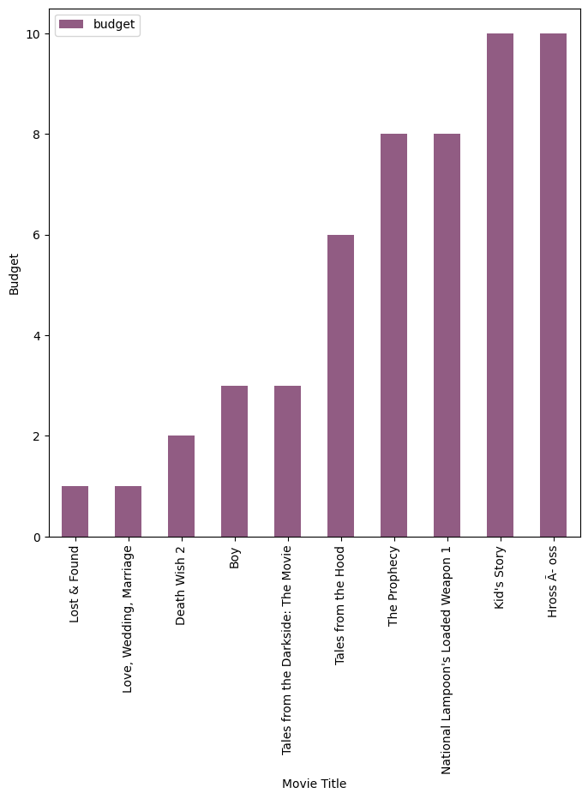
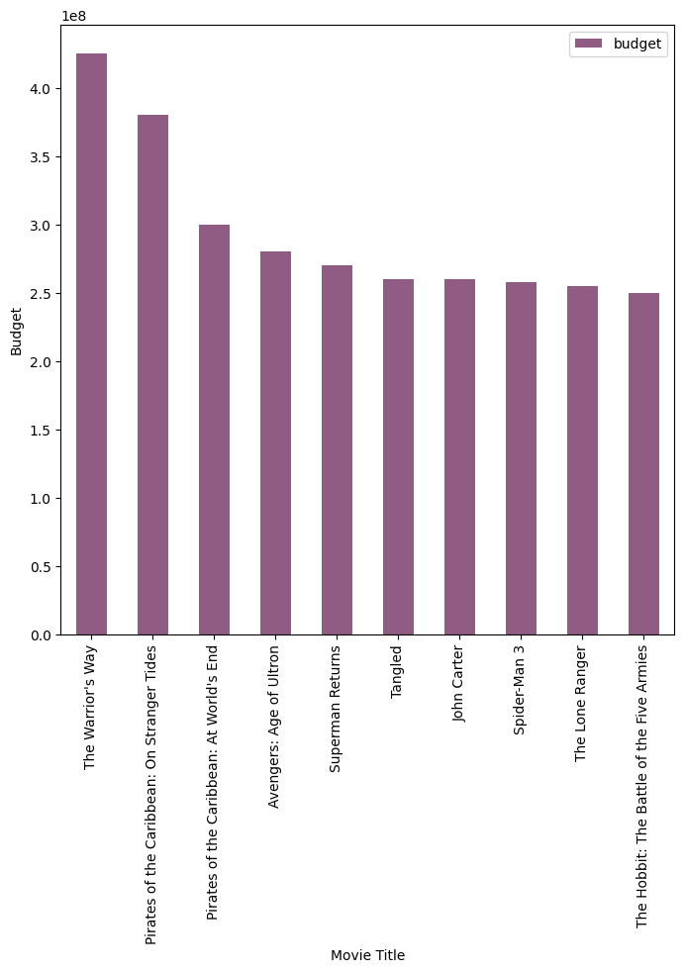
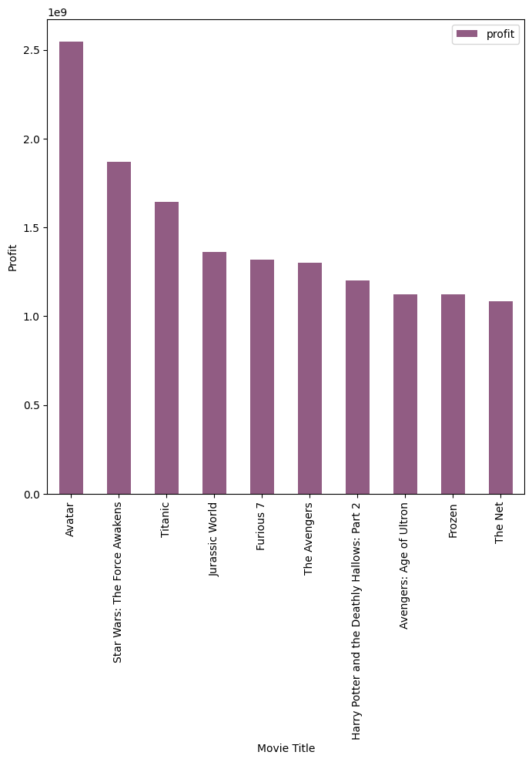
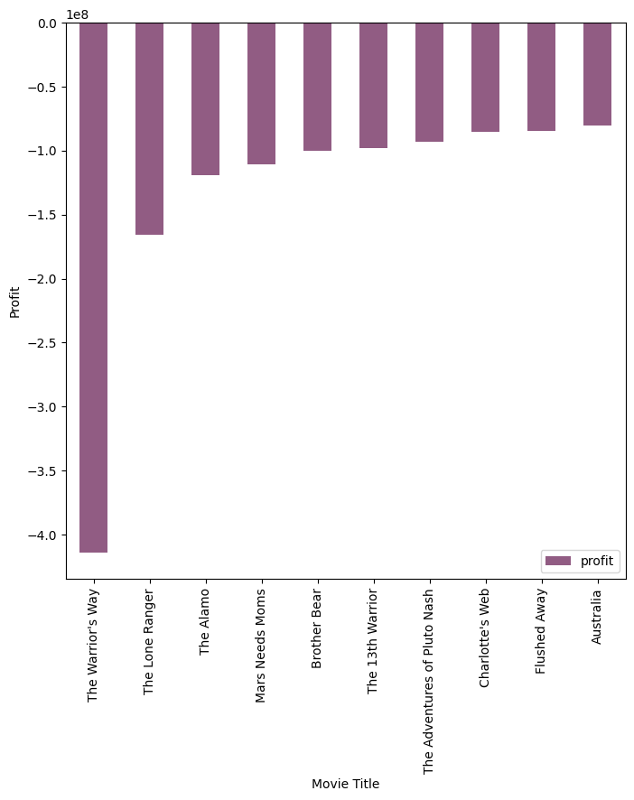
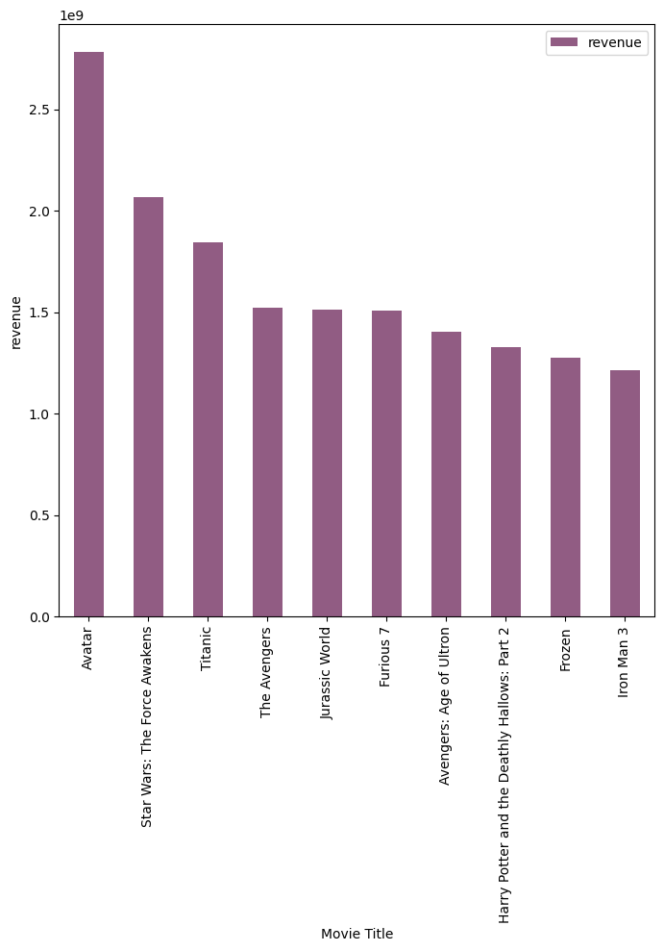
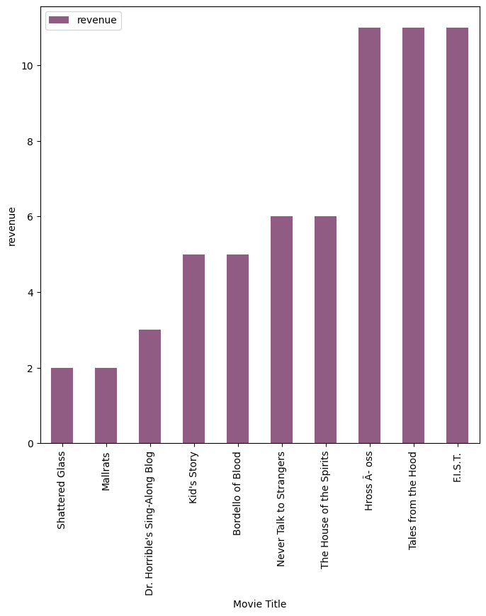
Plots Of Analysis

Slide 8
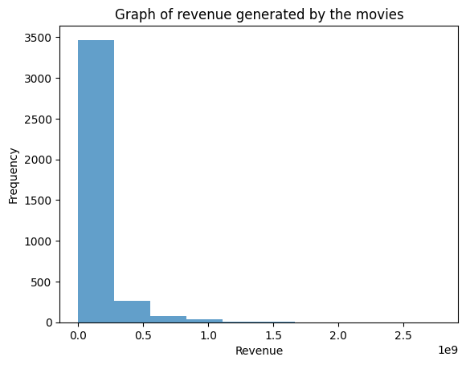
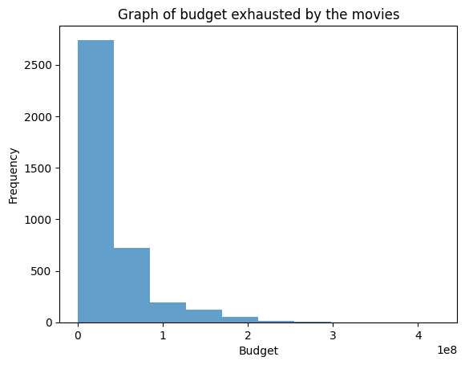
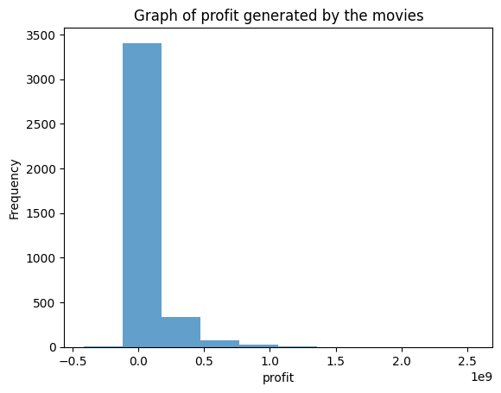
Plots Of Analysis

Slide 9
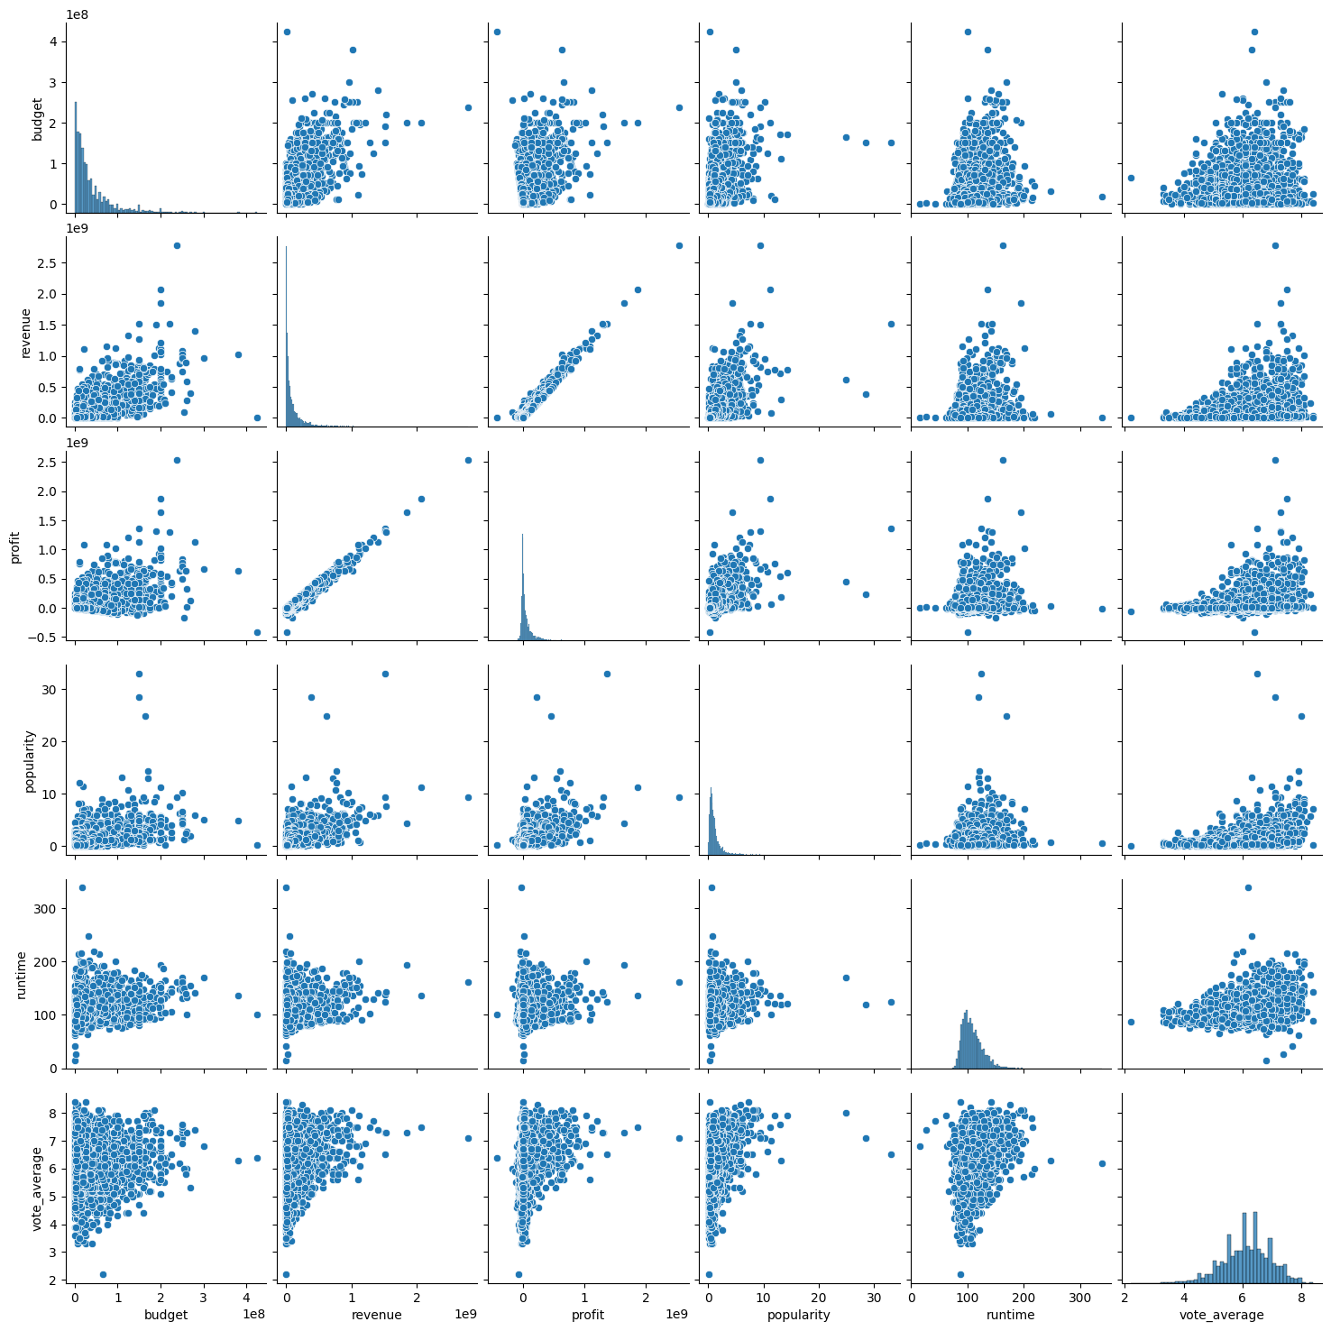
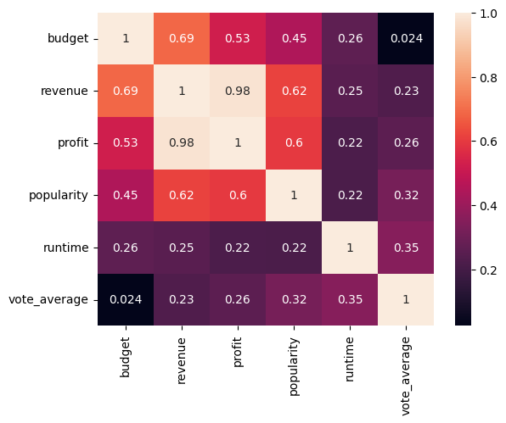
Plots Of Analysis

Slide 10
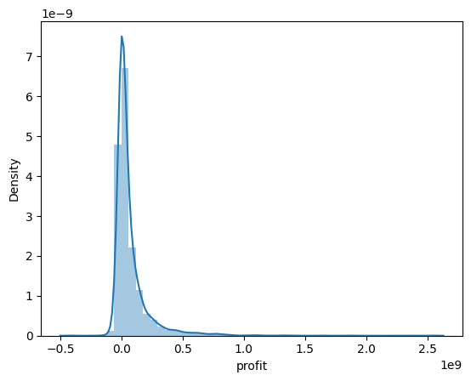
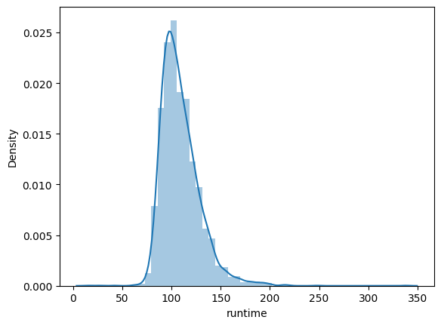
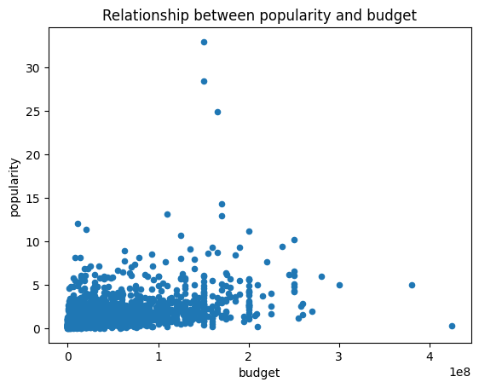
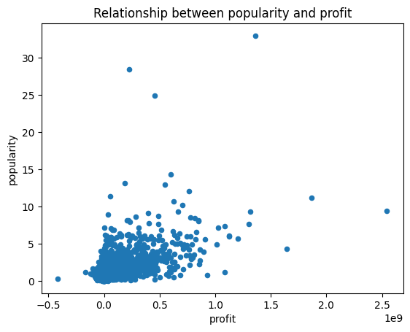
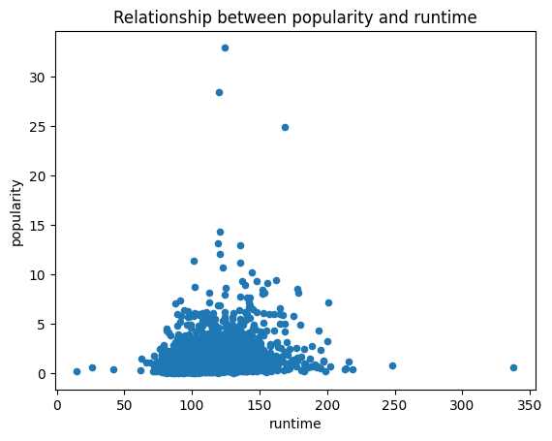
Plots Of Analysis

Slide 11

Overview on notebook
Look well

Slide 12
Conclusion
We see from the datasets that the , Adventure: 749 , Action: 1086 ,Science Fiction: 520, Drama: 1754 ,Thriller: 1204, Crime: 652 ,Fantasy: 396 , Romance: 666 , Music: 134 , War: 119 , Mystery: 344 , Western: 52 movies .
Avatar generated the most revenue and the most profit overall. It also ranks 12th on the all time most popular movie.
• The Warrior's Way exhausted the most budget despite having the least profit.
The most popular movie is the Adventure movie ,titled Jurassic World. Also having an excellent revenue and profit record.
Most of the movie which generated the most revenue and profit had adventure and action in their genres, most movies with comedy and drama generated lesser profit and revenue. This constraint also affected the popularity of the movie. A couple of the movies with the biggest budget didn't generate as much traction, profit or revenue and weren't all that popular.
In the context of popularity and profit, the visualization reveals a robust positive correlation between revenue and budget. Essentially, when a movie has a higher revenue, there’s a greater likelihood that it will generate substantial profit.

Slide 13
Conclusion
In our analysis, we explored the connection between movie popularity and ratings. The chart revealed an interesting trend: highly popular movies tended to receive higher ratings compared to less popular ones. This phenomenon could be attributed to the ‘buzz’ effect—movies that generate significant discussion and capture viewers’ attention often end up with favorable ratings. Conversely, lesser-known films, which may not receive as much viewer attention, tend to have lower ratings
Don't you think this will affect profit? Well, looking at the other correllation matrix table and the scatter plot, we'd notice a positive correlation between profit and popularity. What this implies is that as people keep talking about a movie, recommending it and making the movie trend, the revenue less the budget increases and this is more money for the directors and every one concerned.
So, if you are looking for a movie director to generate a lot of revenue for you then Steven Spielbergis the man for you. He is the all time director with the highest revenue and profit generated.
Let's look at runtime and popularity. The correlation between runtime and popularity depicts a low positive correlation. What does this mean? Well, it means that the popularity of a movie does not really depend on its length. As mentioned above there are other factors that greatly influence popularity based on this dataset.

Slide 14
Thanks

